Slide 1
Capstone Presentation
-Max Norris

Slide 2
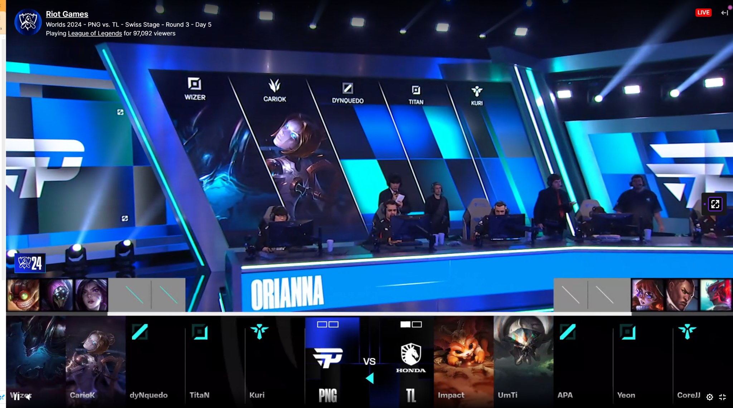
What Is This?
This is a twitch stream…

Slide 3
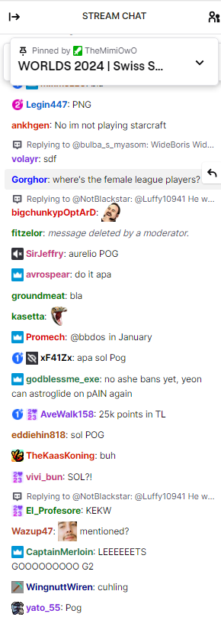
Let’s look at twitch chat, the backbone of any stream

Slide 4
Where did livestream chats come from?
Live stream chat has its roots in early internet communication but became a key feature in live streaming platforms in the mid-2000s. Here’s a brief timeline:
- **2000s**: The concept of live video streaming began to take shape, with platforms like **Ustream** (founded in 2007) and **Justin.tv** (launched in 2007) pioneering the integration of chat features alongside live broadcasts. This allowed viewers to interact in real time, creating a more engaging experience.
- **2011**: Twitch was launched as a gaming-focused offshoot of Justin.tv. It quickly adopted live chat as a core feature, further enhancing community interaction during gaming streams.
- **2013**: Twitch became the leading platform for game streaming, amassing millions of users. The chat feature allowed for dynamic interactions, where viewers could discuss gameplay, ask questions, or share reactions in real time.
- **2015**: YouTube introduced its own live streaming capabilities, incorporating live chat features that enabled viewers to interact during broadcasts, similar to Twitch.
- **2016**: Facebook Live was launched, adding a chat component to its live video feature, further popularizing live interaction across social media platforms.
- **2020**: With the rise of live streaming during the pandemic, platforms like TikTok introduced live features with chat options, making it easier for creators to connect with larger audiences.
Live chat has since become a staple in live streaming across various platforms, fostering community engagement and making the viewing experience more interactive.

Slide 5
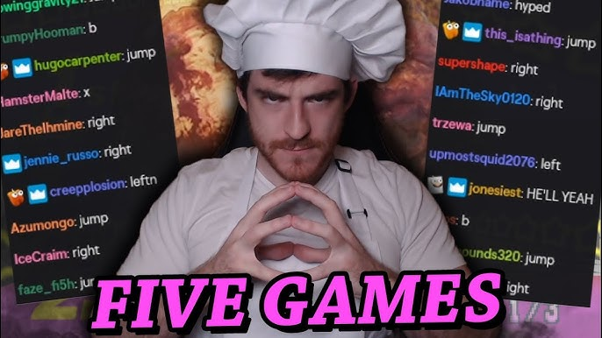
The streamer bounces off on said twitch chat
https://www.youtube.com/watch?v=Xqdt6ZKqRDg&pp=ygUfZG91ZyBkb3VnIGJlaW5nIHJvYXN0ZWQgYnkgY2hhdA%3D%3D

Slide 6
Why Do We Want Twitch chat?
Twitch chat is an invaluable resource for streamers, creating an interactive atmosphere that enhances engagement for both viewers and streamers. This real-time interaction not only makes streams more dynamic but also adds an element of fun that can elevate the entire experience.
I’ve personally made the shift from streaming on Twitch to TikTok, and I’ve noticed a significant difference in the level of interaction I receive. Having a larger audience to engage with, even if it means enduring some playful roasting, has truly transformed my streams. It’s not just about the numbers; it’s about the lively exchanges and the shared laughs that make each session enjoyable and memorable.

Slide 7
For context let's have a look at a streamer who has no chat to bounce off of, like the previous example
https://youtu.be/Pc7sarm4uNs?t=357
Do you see how boring it is in comparison?

Slide 8
Key Insights on having an Active Twitch Chat
Viewer Retention: Streams with active chats have 30% higher average watch times compared to those without (Streamlabs, 2020).
Increased Support: Streamers with engaging chats receive 50% more donations and subscriptions (Newzoo, 2021).
Community Growth: Channels with regular chat interaction see a 40% increase in followers over three months (TwitchTracker).
Real-Time Feedback: Streamers interacting with chat create a more personalized experience, leading to higher viewer satisfaction (International Journal of Human-Computer Interaction).
Enhanced Enjoyment: 68% of Twitch users cite chat interaction as a key factor in their enjoyment of streams (Statista, 2021).
Popularity and Exposure: Active chat engagement can improve a channel’s ranking and visibility on the platform (TwitchMetrics).
References
Streamlabs. (2020). State of the Stream Report.
Newzoo. (2021). Global Esports Market Report.
TwitchTracker. Twitch Channel Statistics.
The International Journal of Human-Computer Interaction. Viewer Interaction in Live Streaming.
Statista. (2021). Twitch User Engagement Survey.
TwitchMetrics. Channel Growth Statistics.
This information highlights the significant benefits of having an active chat during Twitch streams, supporting better viewer engagement and overall success.

Slide 9
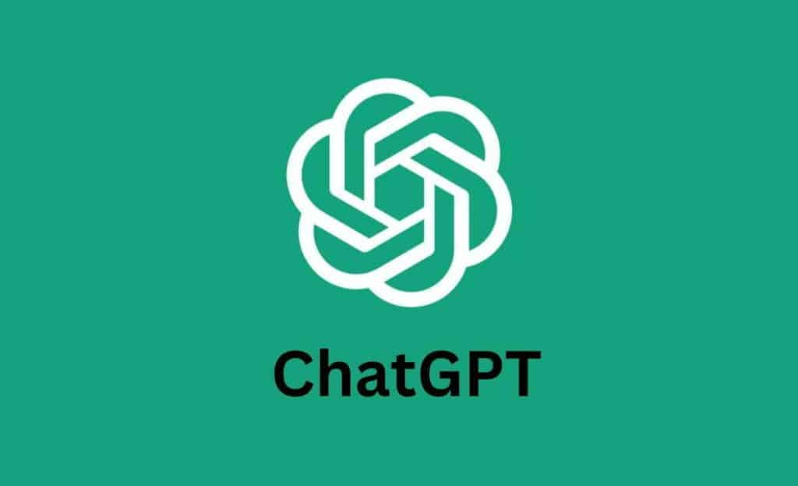
Let’s Make A Real Time AI Based Replacement?
Using ChatGPT API (Python)
There are various versions of ChatGPT, so we will discuss this aspect later on in this presentation

Slide 10
Expected Outcomes
Create a AI System that responds in real time to events on the selected screen (Continuously) to mimic a real time “Twitch” chat for small streamers with no people chatting on the stream.

Slide 11
Response from a big streamer
I attempted to get a response from two big streamers (DougDoug, who has made various videos using the chatgpt api to play chess and such, and DarkviperAU, who is a speedrunner who has some really interesting views on ai content and other ideas), but they declined to comment by the time this presentation was due sadlu.

Slide 12
API Terms and Services
Rate limits: Token-based limits on API usage, which vary based on your plan.
Token usage: Token limits per request, with different models having different capacities.
Content policies: Prohibitions on generating harmful, abusive, misleading, or illegal content.
Privacy: OpenAI advises against sending personal or sensitive data; logs are retained temporarily.
Attribution: You must credit OpenAI if you're using the model in public-facing applications.
Ethical considerations: Use responsibly, especially in sensitive domains or high-stakes decisions.
Terms of Service: Ensure compliance with OpenAI’s terms for continued access to the API.

Slide 13
Plan in steps
Generate api tokens
Write python code to get mic input (Needs various customisation options and features such as noise gate)
Generate API code to Link ChatGPT To Python code
Select ChatGPT Model to focus on (I would prefer one main one and one secondary cheaper one myself)
prompt to setup responses to match input
Check mic is working then move onto the next thing
Write an additional section of code so the screen can be scanned and the chat can also react to it (Eg react to subtitles, kills or final race position)
Get PC Audio input (Different to mic input)
Design The way to display responses (Compatible to obs)
Test, Test and Test again, Then Enhance and Test Again
Finalize
Extra task
See if I can look at integrating with the actual twitch and youtube api to put the messages directly into the chat, however it may have issues being multiple bots with random names. I also want to look at making possible custom icons before the name, which is not like twitch but like youtube.This will be researched in the background

Slide 14
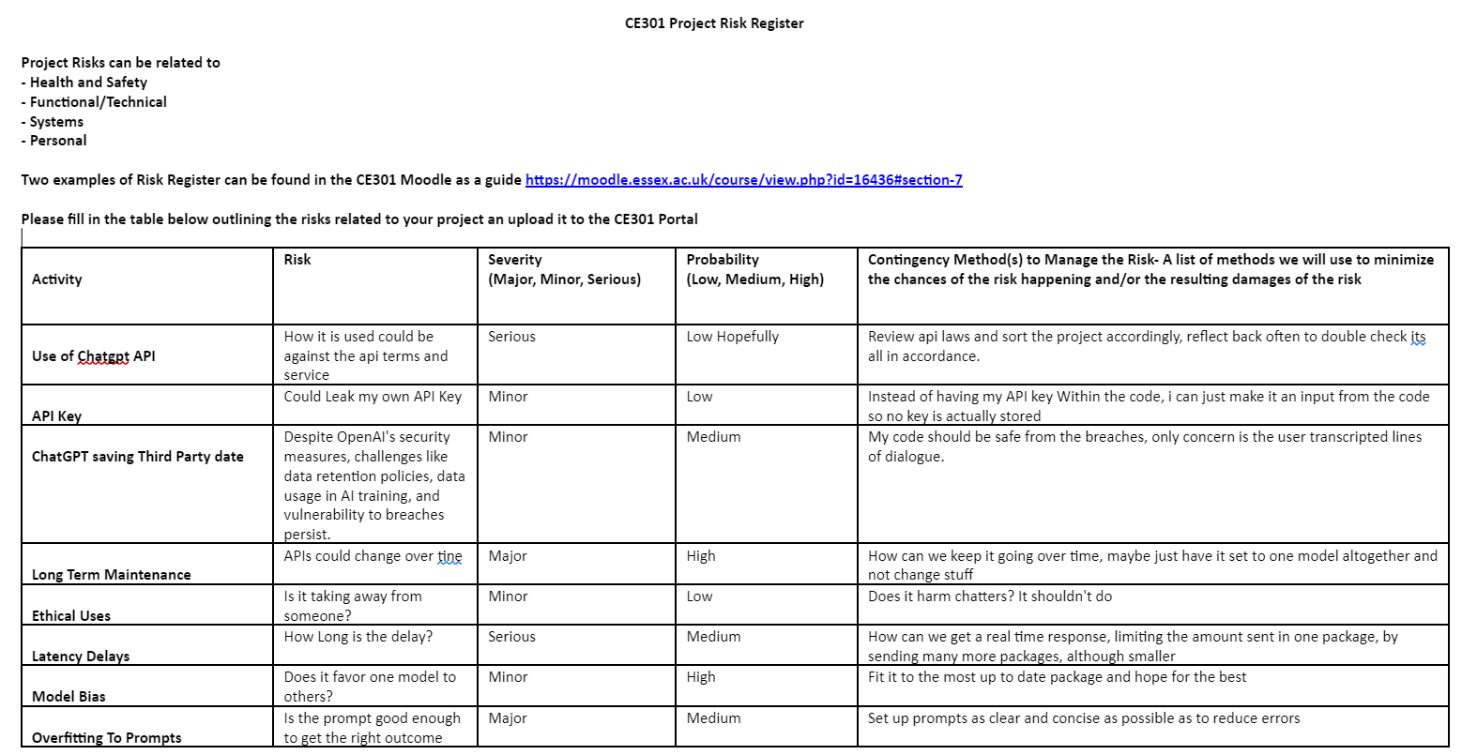

Slide 15
Next we will speak about some previous products and software similar to this.
Any Questions so far?

Slide 16
Anything like this before?
Ai_licia (this program seems to be like some other programs, an ai based moderator, which is not an ai based stream chat, which is what i am aiming for
Streamerbot is another program that creates a single chatter, which you link with the twitch api and type in chat as comunication, which different to my idea in a few ways.
https://aitwitch.chat/ this is an ai chat similar to streamerbot, and faces the same issues
As you can see there is multiple bots doing multiple things, but they all work directly with twitch or youtube using apis,
whereas with my project, I plan to use the streamers mic, game audio, and even the actual contents of the monitor (Selected by user) which makes proper and custom real time responses, which is brand new concept, done in a different way, hosted on the “Streamer’s” computer.
This could also be used as live presentation feedback for practice and other useful applications.

Slide 17
What do we need?
Mic Input = Speech recognition? What Package? (PyAudio most likley)
Screen reading = Using GPT4 - Vision?
API Key = ChatGPT Key
Audio Input = PyAudio
Output Display = Undecided, see next slide

Slide 18
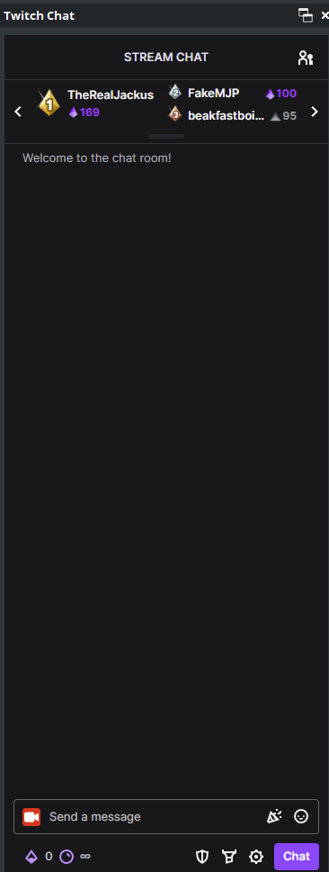
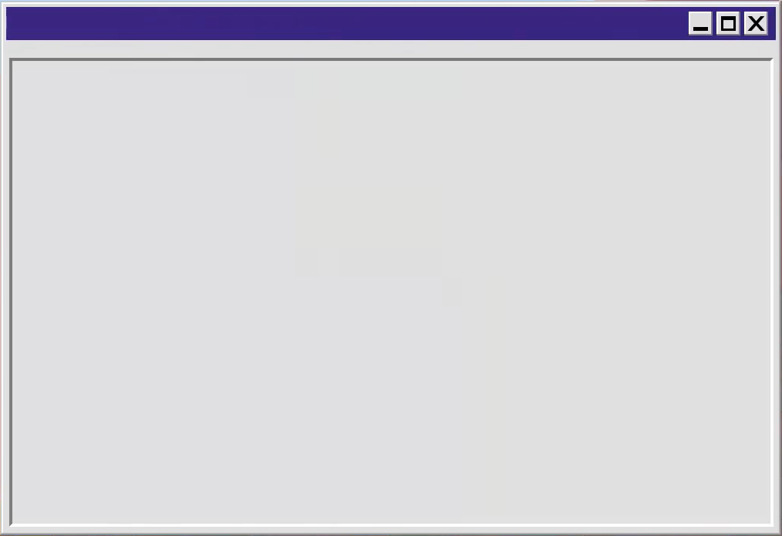

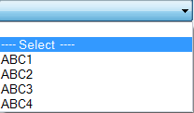
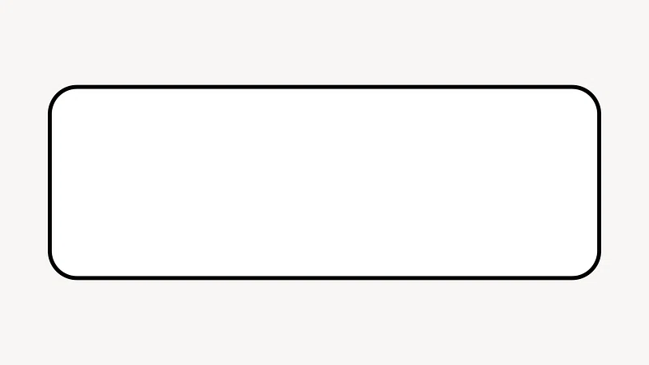
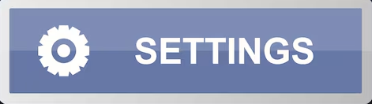

Design concept
AI CHAT SETTINGS
User1: This is so poggers
User2: I’ve seen better
User3: what game is this?
User4: still poggers
User5: oops (Skull Emoji)
User3: Love this game
Set Mic Input?
Set Screen To View?
Set Audio Input (monitor, not Mic)?
Set Message amount (Character Limit)?
Set Stream Title Input?
Set Stream chat settings
Click to modify text design

Slide 19
One main issue is deciding how to display output
Here are some conceptual main ideas before researching
CMD (Can be customised easily enough, but is in the cmd so good as a last resort)
Reading and writing to a file (reliable but slow and inefficient)
Basic python output (Too simple but alright as a backup)
Webpage source (Could be good but have to reload webpage Repeatably)
Here are some other ideas that I plan to look into as alternatives to the previous potential ideas.
Curse terminal library
GUI Using Tkinter
Rich Libary (Fancy Terminal output)
TUI for Textures

Slide 20
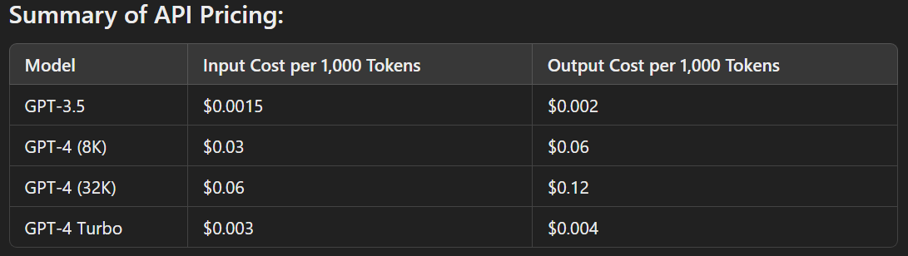
Is API Key Use Expensive?
No! From the price breakdown it seems relatively cheap, wth the best API (Version) being roughly twice the price of the cheapest API (Version).
(1000 tokens is roughly 750 words)
250,000 words Divided by 750 = 333.3 (Recurring)
333.3 X 1000
$3.3 Div 1000 = 0.003 Recurring
So 250k words works out to roughly $3 in cost
(Cost Estimate for GPT4 - Turbo (Most expensive))
Lets double the input cost to give a rough minimal idea on how much both input and output cost would be. Roughly $6 but lets call it $7 to be safe.
At (current exchange rate) $7 = £5.36. So that’s roughly £5.36 for 250k words for both input AND output Each, meaning this is very cheap in all fairness
(“You might see around 300 to 1,000 messages per hour, depending on the level of engagement. If we assume an average of about 10 words per message, that would translate to roughly 3,000 to 10,000 words per hour. This can vary based on the streamer's style and how interactive they are with their audience.”) With my program we can control the amount of messages and output however.

Slide 21
Customisation options planned
Various text options (Font, size, color, bold, and ect)
Allow Screen Reading? (Yes Toggle box, Then drop down for each monitor)
Mic Input? (Yes, toggle (Uses default main mic)
Api Version (Drop Down menu?)
Stream Topic (Text input, guidelines will be found and given in future)
Record game audio (Yes, Toggle box)

Slide 22
Any Final Questions?

